Slide 1
Sweidish Riksdag 1867–2022: An ecosystem of linked open data
Fredrik Mohammadi Norén

Slide 2
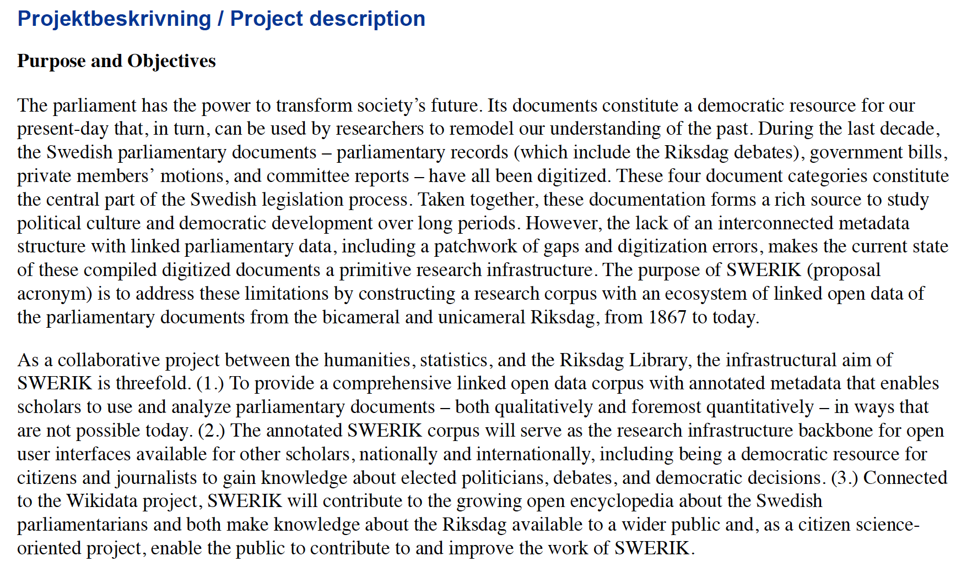
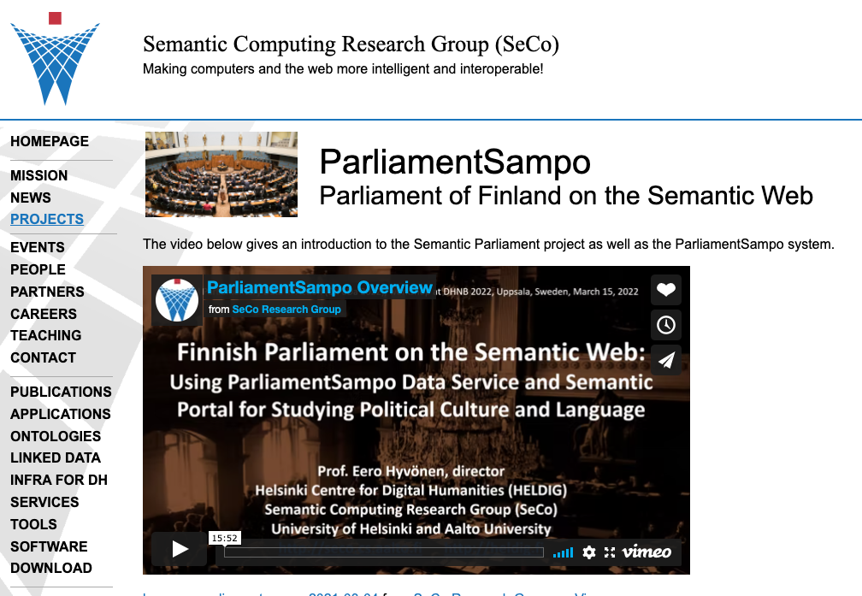
Sweidish Riksdag 1867–2022: An ecosystem of linked open data
Research infrastrucure project
Riksbankens jubileumsfond
5,2 million SEK
3 year project (2023–2026)
Together 2 full time positions:
Fredrik M. N. (PI): 30 %
Måns M.: 30 %
Datakurerare: 100 %
Riksdagsbiblioteket: 40 %
Purpose: create a database with metadata for all members of parliament since 1867, and connect MPs to debates, motions, bills, committee reports
Notes:
Together with some colleauges and the Swedish Riksdag Library I have submitted the research infrastructure application: ”Swedish Riksdag 1867–2022: An Ecosystem of Linked Open Data”
Aims to create a database of MP metadata and connect metadata to the textual data – which member of parliament that took part in which debate, was member in which committee and which motions he or she wrote – from the establishement of the bicameral riksdag in 1867 to today
What questions were distinctly coded as female and male topics? + How have urban and rural areas been discussed by MPs who represented cities and villages? + How have different parties discussed issues of freedom and equality? And how has all this changed over time?
This project idea is very much inspiered by the Finnish project ParliamentSampo led by Eero Hyvönen

Slide 3
Purpose
The Swedish parliamentary documents are digitized – but there is a lack of a MP database structure with (A.) MPs' metadata that (B.) is linked with relevant documents – which debates they participated in, which motions they wrote and which committees they sat on et cetera – from 1867 to today.
Three stated purposes:
Create a research corpus with linked open data.
Make the SWERIK corpus the basis for user interfaces where the parliamentary data can be explored – and function as a democratic resource for citizens and journalists.
Connect the MP database to Wikidata/Wikipedia and thus contributing to the knowledge about Sweden's Riksdag to a larger public – and that the public in turn can contribute to improving SWERIK.

Slide 4
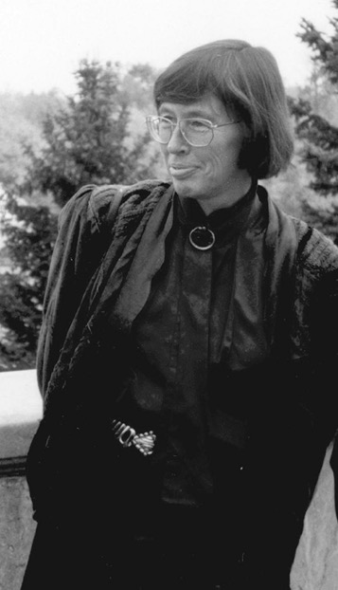
Example: The links of Birgitta Dahl
Metadata
MP 1969–2002
Speaker 1994–2002
Social democrat
Woman
Born 1937
Minister 1982–1991
Etc
Debates
Child care
Environment
Energy
Etc
Committee reports she took part in
Motions written as MP
Bills as responsible minister
Notes:
And then do this for ALL MPs – creating a database for various research purposes

Slide 5
Target groups
Researchers (Swedish and international)
Citizens and journalists
Politicians and officials

Slide 6
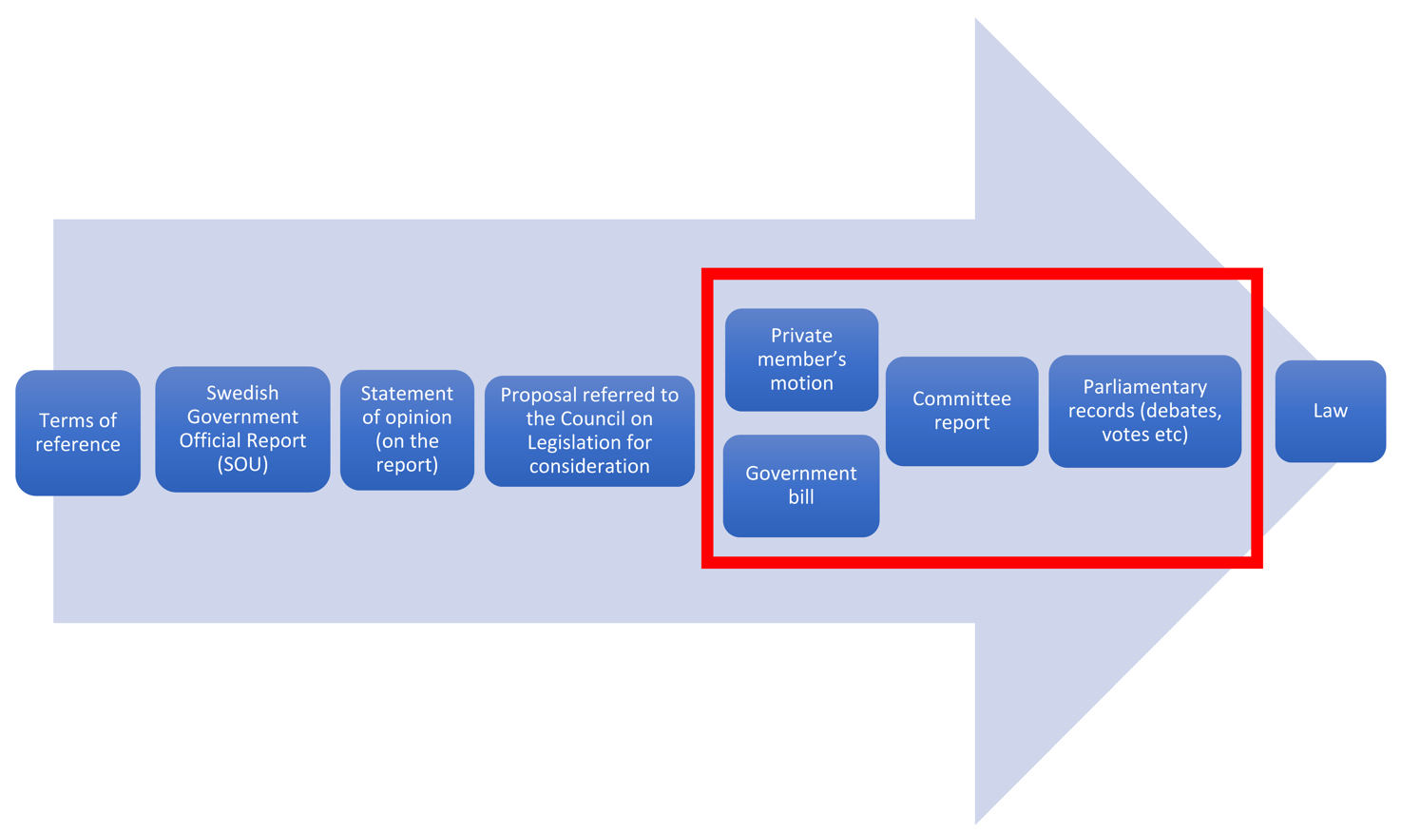
Data: The Swedish Parliamentary Documents
The core of the application:
Parliamentary records
The Swedish legislation process
Focus in application
Notes:
Focus in the application: parliamentary documents, hence documents that pass through the Riksdag

Slide 7
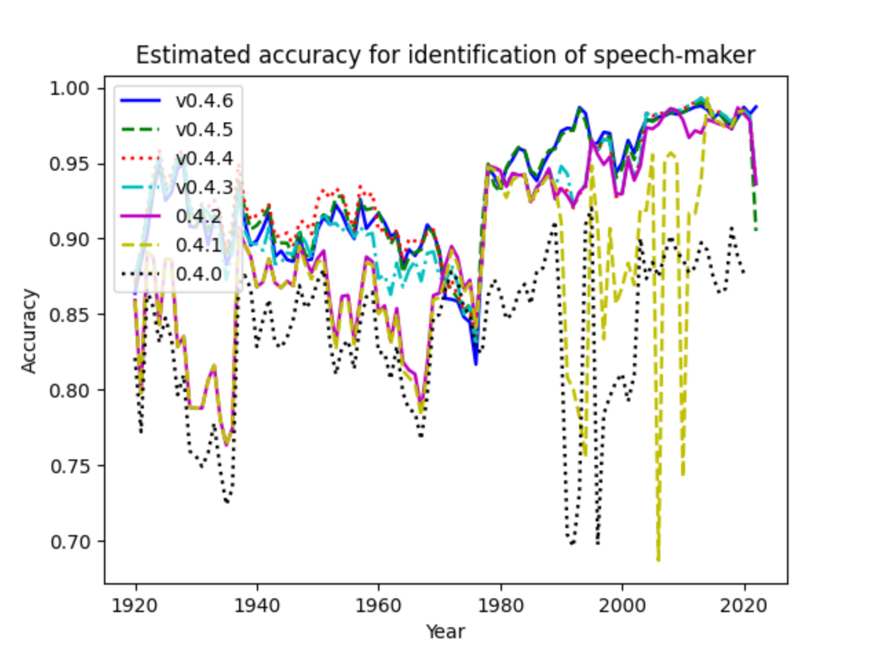
https://www.westac.se
Building a pilot corpus 2020–2022: annotated parliamentary debates 1920–2020 within the project Welfare State Analytics. Marking up who speaks, what is a speech, and what is not a speech. So far we have aimed for a 90 % annotation quality.
Notes:
Swedish research council 2019–2024
Mix of humanities scholars, statisticans and system developers

Slide 8
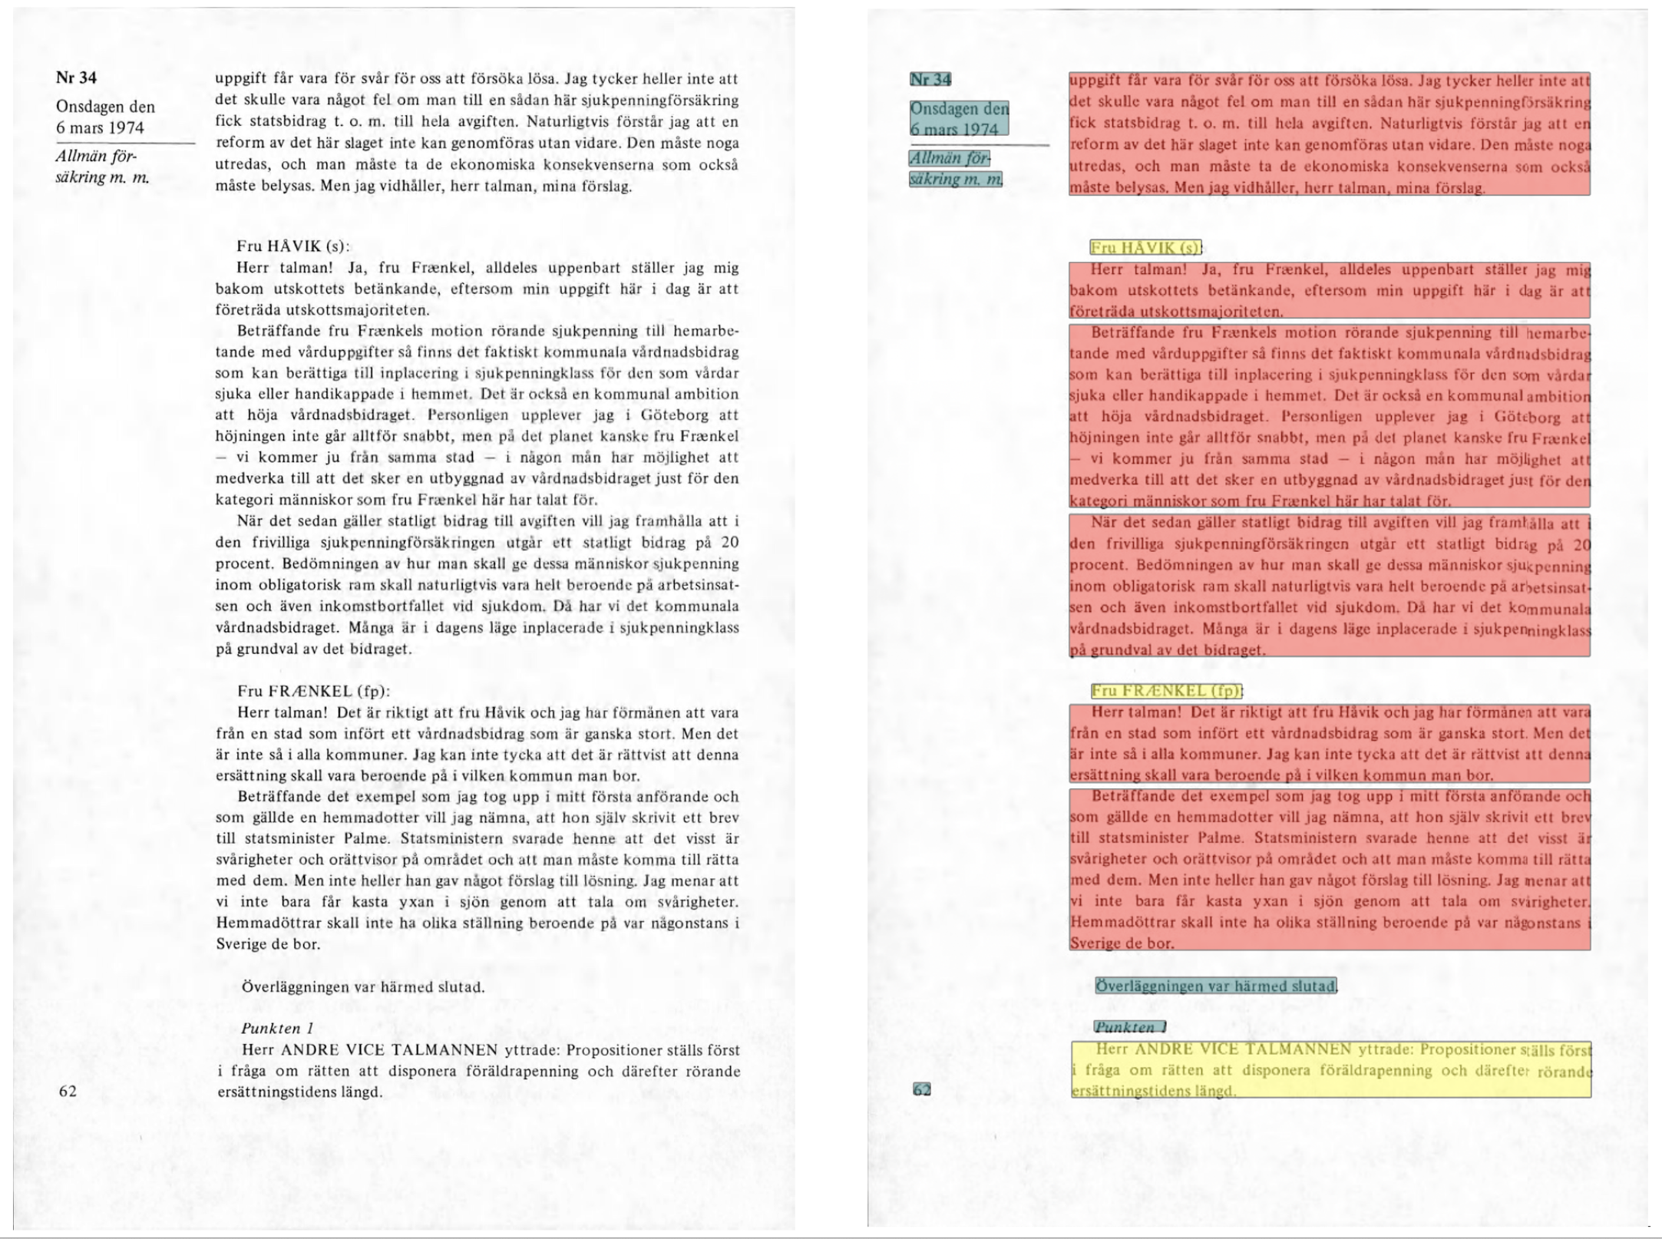
Agile corpus curation. Combination of machine learning and manual work.
Identified MP speaker introduction – and create a speaker database with metadata for name, party, gender, age etc.
Identified speech
Identified non-speech

Slide 9
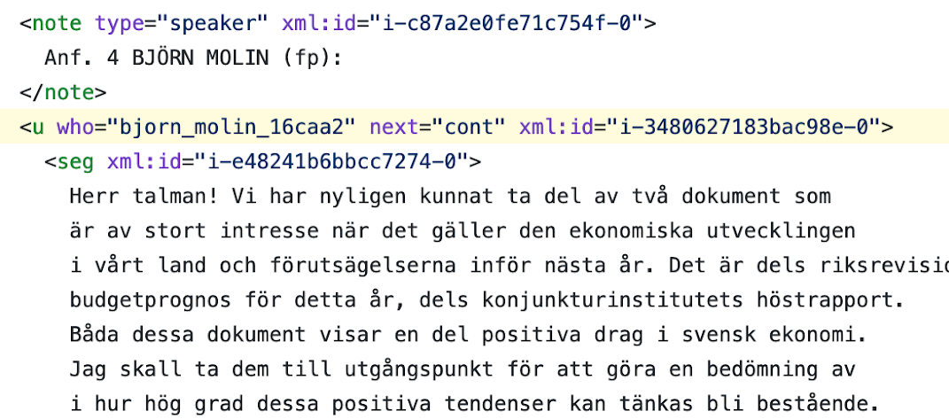
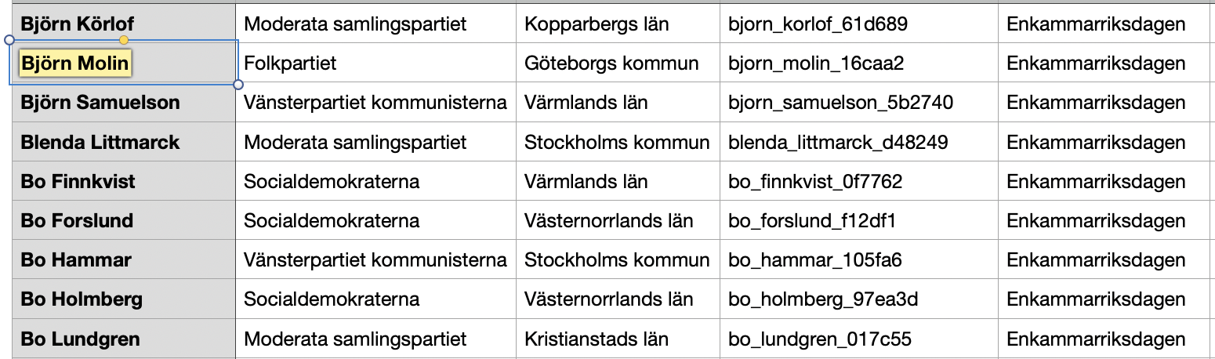
We have generated a database of MP metadata that is used to connect identified speaker to correct metadata. The MP database is connected to Wikidata.

Slide 10

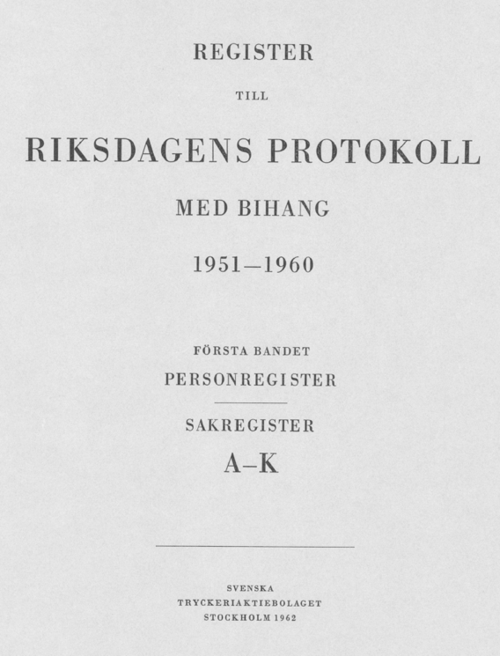
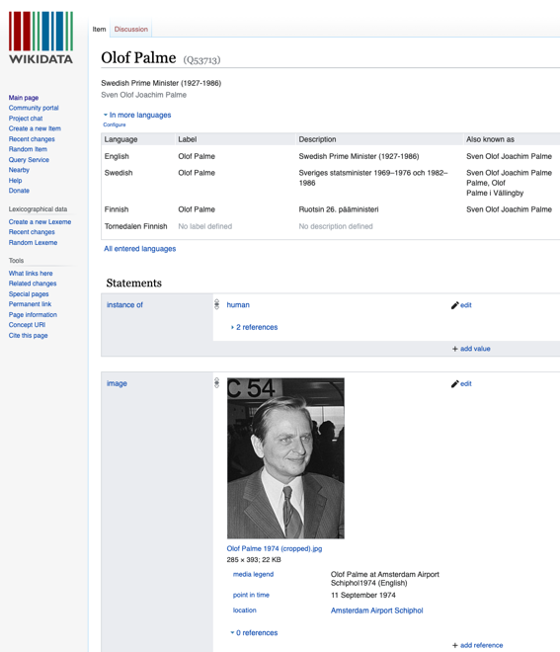
Question of metadata
Some metadata of interest: gender, party belonging, geographical representation
No database of Swedish MPs exists that covers the period before the 1990s (!)
Using various sources, digitized and digitally born, to build such a database of MP metadata
Notes:
The Swedish State Calendar – who is who in the public sector
The register of the Riksdag
Wikipedia / Wikidata – both using exisiting lits of MPs and metadata + collaborating with volunters from Wikidata
– efficient to some extent, but not immune to gaps in the metadata:
Some people and eras are missing
Some aspects (gender, occupation) are missing
→ these will also be fixed by manually adding metadata to Wikidata

Slide 11
Some examples of errors in annotating MPs in the parliamentary debates (Kammarens protokoll)

Slide 12
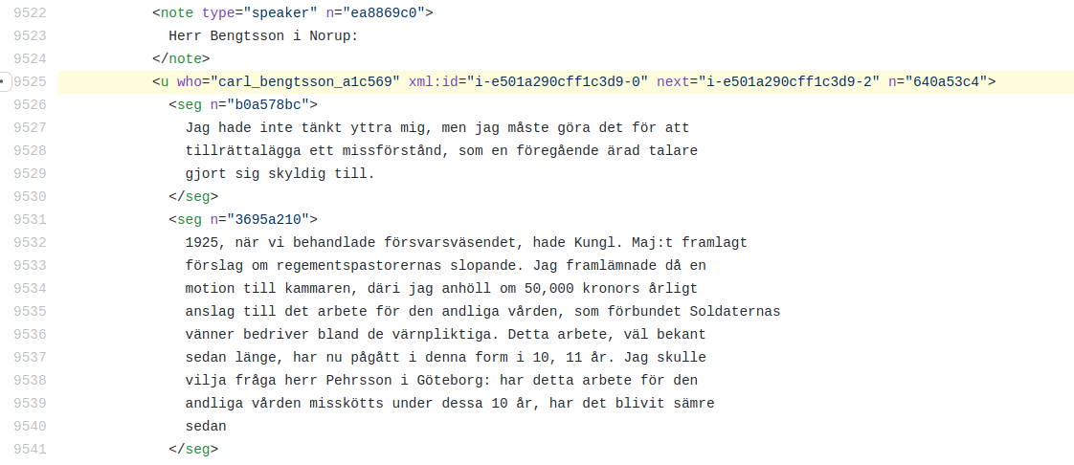
Wrongly tagged person OR wrong gender
Problem when MPs are only presented with surname:
"Herr Bengtsson i Norup” is tagged as Carl Bengtsson, when it is in fact Sven Bengtsson
Notes:
We try to fix these errors by improving usage of metadata – here for example by identifying MP using geographical information (Norup)

Slide 13
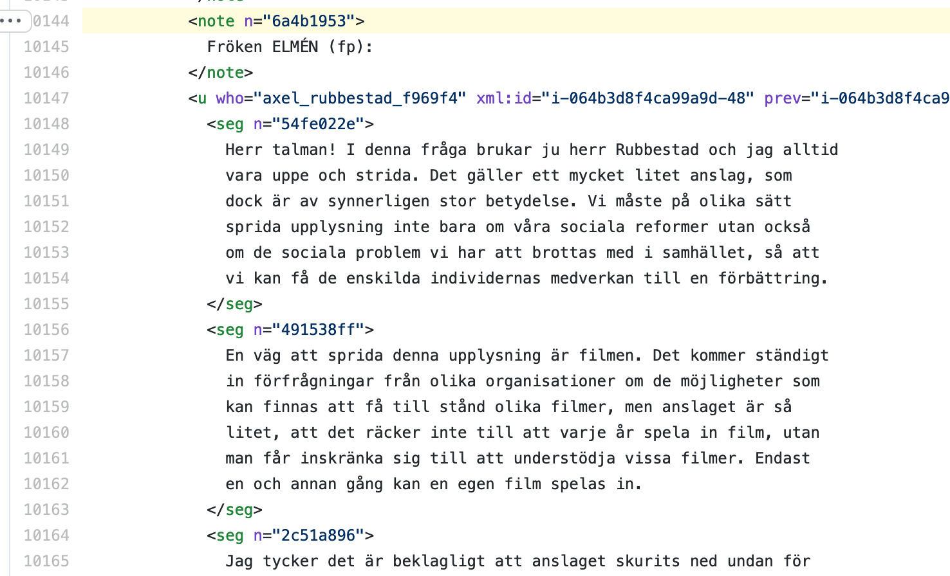
The introduction of “Fröken ELMÉN (fp):” is not identified as a speaker introduction – this speech is therefore tagged as the previous speaker (Axel Rubbestad)

Slide 14
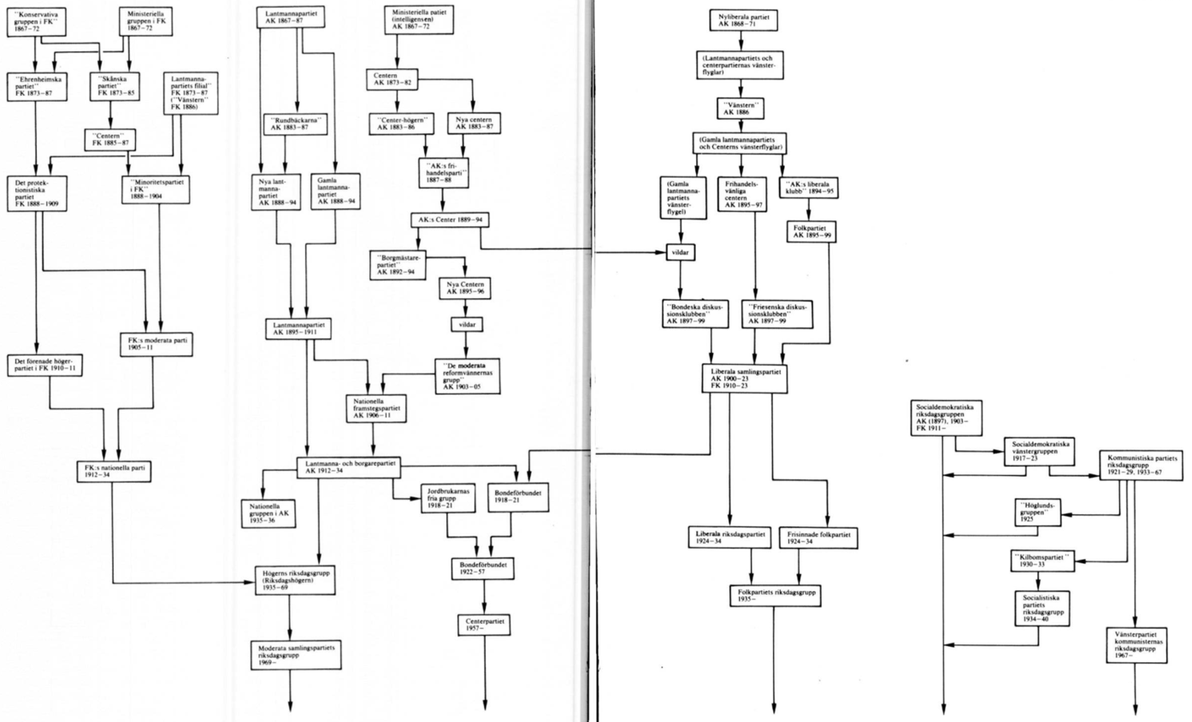
Complex data – calls for different competencies
Changing text structure
A hierarchical tree of party formations and party splits 1867–1970
Representing complex historical procesesses
Statisticians
machine learning +
agile corpus curation
Riksdag Library
source knowledge +
end product owner
Wikidata
linked data + public use
Moderate Party
Notes:
The illustration that displays a hierarchical tree of how the party formations and party splits developed during the bicameral Riksdag, from 1867 to five parties in the Swedish parliament in 1970

Slide 15
Rådgivande grupper
Domestic advisory group
Hanna Bäck (Lunds universitet)
Jonas Harvard (Mittuniversitetet)
Josefin Hägglund (Södertörns högskola)
Martin Malsten (KBLab/KB)
Leif-Jöran Olsson (Språkbanken/Göteborgs universitet)
International advisory group
Jo Guldi (Southern Methodist University)
Eero Hyvönen (Aalto University)
Pasi Ihalainen (University of Jyväskylä)
Maciej Ogrodniczuk (Polish Academy of Sciences)
Paul Seaward (History of Parliament Trust)

Slide 16
Five work packages (WP1–5)
WP1 – annotate persons and content in the parliamentary data.
WP2 – build a database with metadata for all members of parliament.
WP3 – create an infrastructure where MPs in the database are linked to related parliamentary documents.
WP4 – align the annotated parliamentary corpus with ParlaMint – an international infrastructure standard for the annotation of parliamentary data, enabling international researchers to conduct comparative studies of national parliaments.
WP5 – integrate the SWERIK corpus into the Riksdag's web and facilitate the usability of the corpus for various users both inside and outside academia.

Slide 17
Project group: PI, machine learning expert, corpus curator, Riksdag Library
WP2
Build a database of MP metadata
Year 1–2
WP1
Curate and mark up parliamentary documents
SWERIK – Aims:
1. Linked open parliamentary documents 1867–today
2. Backbone for open user interfaces
3. Wikidata collaboration
WP3
Link MPs with parliamentary documents
Project time line
International advisory board
Domestic advisory board
Year 3
WP4
Convert corpius into an international markup standard
WP5
Enable the SWERIK corpus to be utilized by different users
User groups:
Researchers
Citizens & journalists
Parliamentarians
Continuing corpus curation:
Research projects
Wikipedia/Wikidata
Riksdag Library
After the project

Slide 18
Thank you!

